Slide 1
Military Spending
2006-2016 (20 countries)
Kyi Win
March 4, 2016

Slide 2
Overview
Source of the Dataset
Exploration of the Dataset
Compare the data to country’s GDP
Compare the data to overall military spending of the all 10+ countries
Compare per person military spending to the per person GDP
What are the fastest growing countries in military spending?
Conclusion

Slide 3
Source of the dataset
The dataset is obtained from SIPRI Military Expenditure Database.
SIPRI is an independent international institute dedicated to research into conflict, armaments, arms control, and disarmament.
The dataset includes data from 172 countries from the period of 1949-2016.
Extracted 3 worksheets from the dataset excel workbook that contains 8 worksheets. 3 worksheets are :
Military expenditure by country in constant US $
Military expenditure by country as percentage of gross domestic product
Military expenditure per capita by country

Slide 4
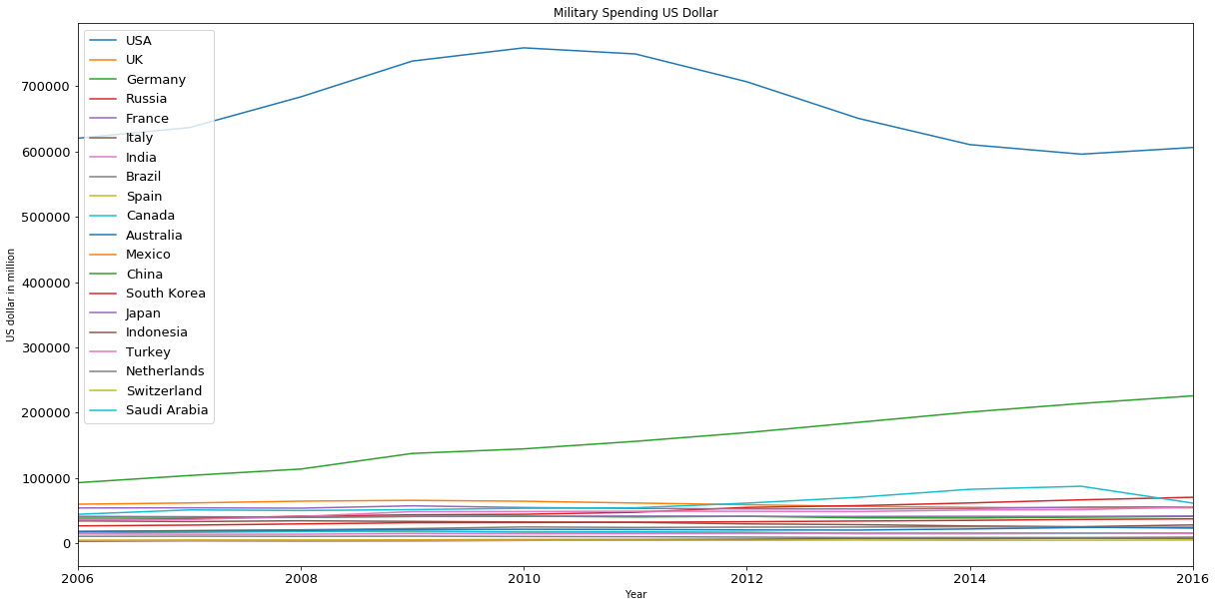
Exploration of the Datasets
Notes:
20 highest GDP countries were selected for this project. This graph shows that the country that spend the highest in Military spending in US $ is the United State and the China taking the second place in Military spending. The other countries spend less than 100 thousand in million for military expenses. Military spending of China is increasing over the past 11 years.The dataset : Military expenditure by country in constant US $ is used for this graph. 600 thousand in million.

Slide 5
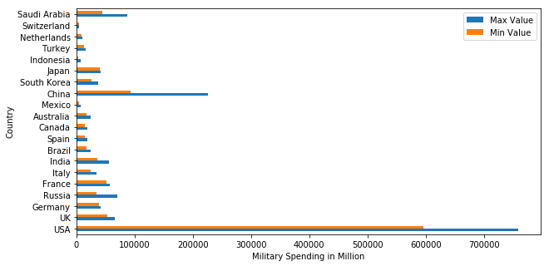
Exploration of the Datasets
Data type = object
Maximum value spend
Highest- USA (2010)- 758890 million
Lowest- Switzerland (2016)- 4828 million
Minimum value spend
Lowest- Indonesia (2006)- 3043 million
Highest- USA (2015)- 596010 million
Notes:
In this graph, Max and Min Value of military spending, and the year of Highest and Lowest is explored. Highest Maximum value spend in Military spending is US with 700 thousand in million in 2010 and the lowest in maximum value spend military spending is Switherland in in the lowest spend value is below 60000. The lowest in the minimum value spend in military spending is Indonesia in 2006, and the highest in minimum value spend in military spending is USA in 2015. In 11 years, US spend the most in military spending that the lowest amount US spend in military spending is higher than the highest amount all the other countries has spend. The dataset : Military expenditure by country in constant US $ is used for this graph.

Slide 6
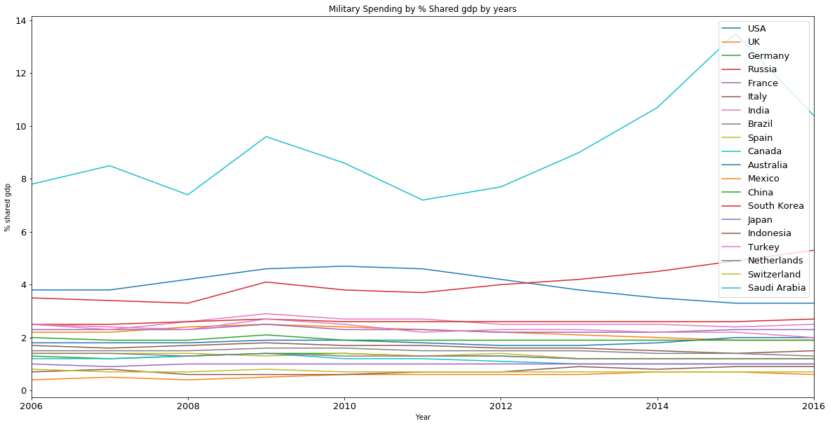
Compare the data to the country’s GDP
Notes:
This graph shows the shared gdp % of total gdp of the 20 countries. Compared to the country gdp, Saudi Arabia spends the most % of shared gdp in Military spending, followed by Russia, then USA.
The dataset: Military expenditure by country as percentage of gross domestic product is used.

Slide 7
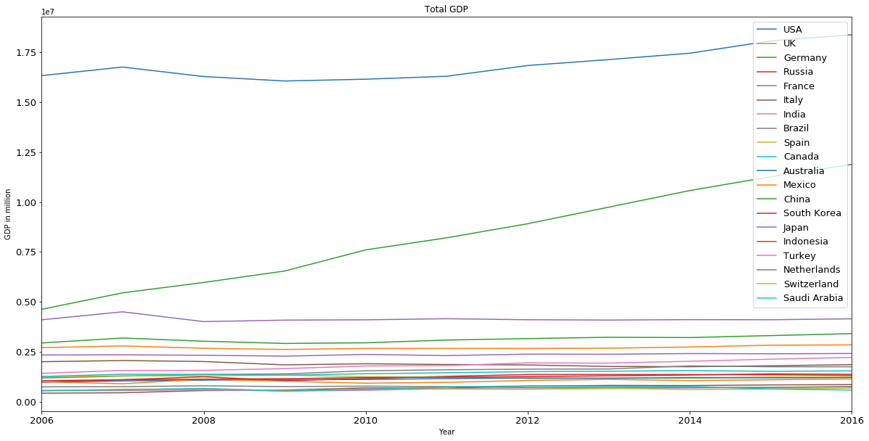
Compare the data to the country’s GDP
Notes:
This graph shows the total gpa calculated using the military spending and shared gdp%. From 2006 to 2016, the total GDP of the United States stays high compared to other countries. However, the china GDP has continue to increased steadily over the years.

Slide 8
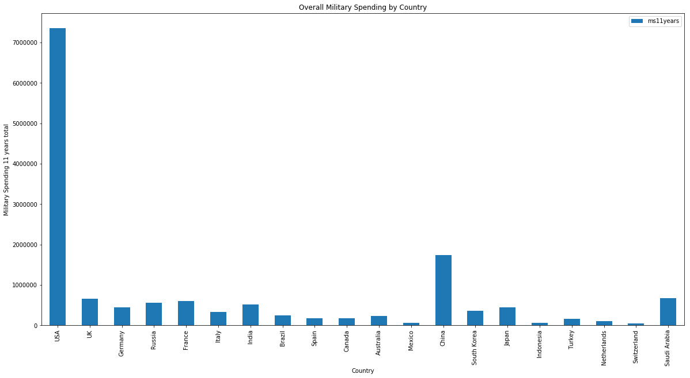
Overall Military Spending of 11 years
Notes:
From the overall military spending of 11 years graph, the United State spends the most in overall military spending, which is followed by China, then Saudi Arabia.

Slide 9
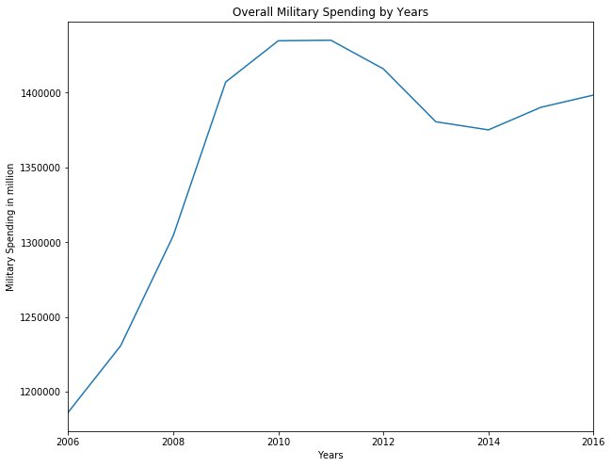
Overall Military Spending (20 countries)
From the overall military spending of 11 years graph, the United State spends the most in overall military spending, which is followed by China, then Saudi Arabia.
From the overall military spending by years, 2011 is the year when overall military spending was highest, and 2006 is the lowest.
Notes:
This huge increase can be from US’ increased amount in military spending.

Slide 10
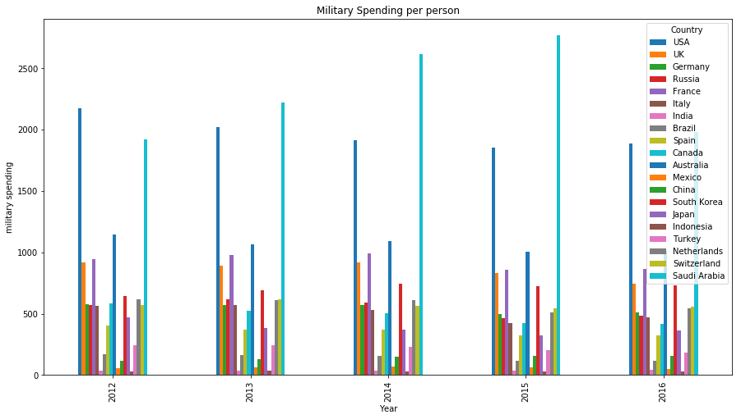
Military Spending per person
Notes:
Here, we compared military spending to the per person GDP. The highest military spending per person is the United State and Saudi Arabia, and In 2015 Saudi Arabia is the country that spends the highest in per person military spending.

Slide 11
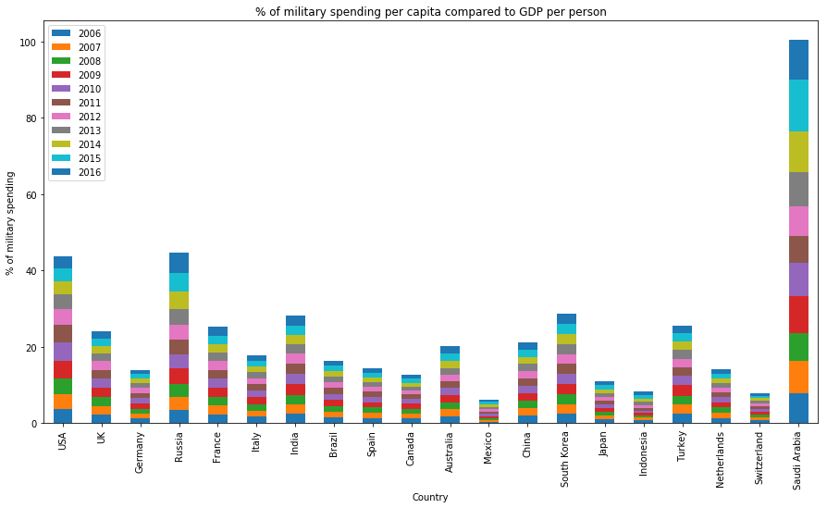
Compared military spending per capita to GDP per person
In 2016, the military spending per person is 3.3 % of per person GDP in US, and the military spending per person is 10.4% of per person GDP in Saudi Arabia. The highest is Saudi Arabia, and the lowest is Mexico.

Slide 12
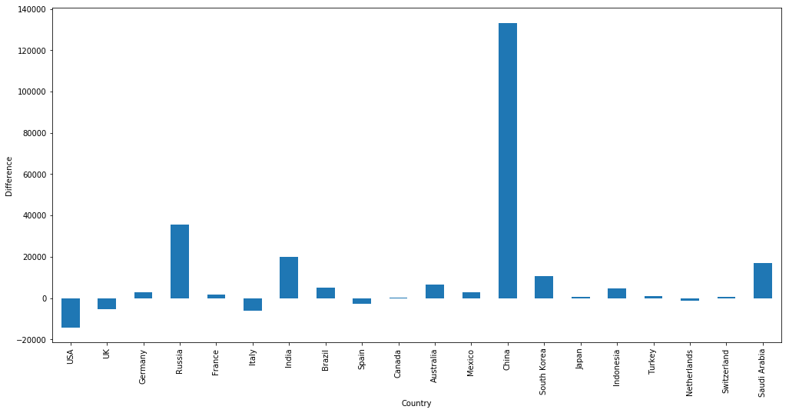
Military Spending growth in fixed value
Notes:
The difference between military spending from 2006 and 2016 tells how much the military spending has grew. China grows dramatically military compared to the amount that is spend in 2006. Canada has not change much from 2006, and US’s military spending is going down.

Slide 13
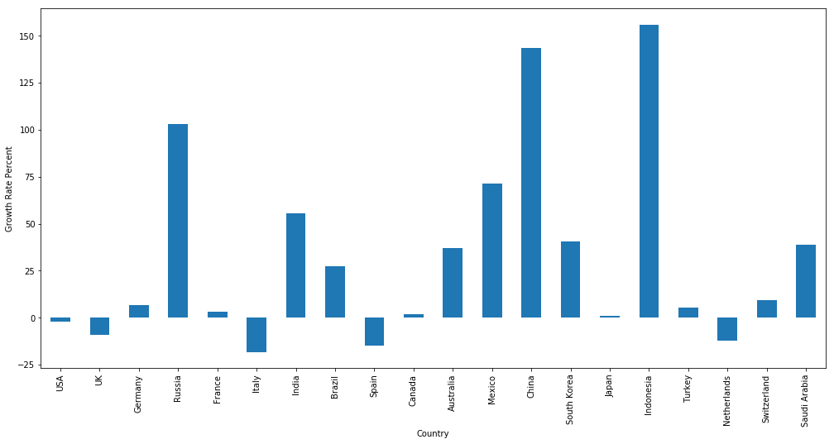
Military Spending growth in percentage
Notes:
In this graph, growth rate percentage is calculated, and it is kind of interesting to see that Indonesia is the fastest growing country in growth rate in military spending even though indonesia is lowest spend in dollar in military spending currently, per capita spending and overall military spending. China is taking the second place, then Russian , Mexico, India, and then Saudi Arabia. US has a small decline in growth rate percentage.

Slide 14
Conclusion
USA is found to be the country that spend the most in military spending that its lowest amount spend in a certain year higher than the highest amount spend by all the other countries in 11 years.
Saudi Arabia spend the most % of Gross Domestic Product (GDP) in Military Spending. Russia take the second place in % shared gdp, and US is taking the third place.
The top two countries with Highest Gross Domestic Product is USA and China.
The past 11 years of overall military spending combined shows that US spends the most in military spending, followed by China and Saudi Arabia.
2011 is found to be the year of highest in overall military spending, and 2006 is found to be the lowest in overall military spending.
Saudi Arabia and USA is found to be the two countries with highest in military spending per capita.
The military spending per person is 10.4% of per person GDP in Saudi Arabia, while US is 3.3% in 2016. Mexico has the lowest percentage when comparing per person military spending to per person GDP, Saudi Arabia is the highest.
The difference in growth in military spending says that China has increased in military spending dramatically over the past 11 years while Canada spending stays the same, and US is going down in military spending compared to 2016.
While Indonesia spend very low amount in dollar in military spending out of 20 countries with highest GDP, it is found to be the fastest growing country in growth rate, followed by China.

